Slide 2
Purchasing & Contracts: Who are we?
Linda Bertolucci, Director Purchasing & Contracts
Paul Wassmer, Contracts Specialist
Amy Leasure, Senior Buyer
Maria Briney, Intermediate Buyer
Melody Wells, Intermediate Buyer
Sandy Pennock, Purchasing Assistant

Slide 3
We are also the only individuals with the legal authority to commit the District to payment of invoices from vendors for materials, equipment and services.

Slide 4
AP 6330
Purchasing
Reference:
Education Code Section 81641, et seq; Education Code Section 81550, et seq; Public Contract Code Section 20650, et seq; Government Code Section 12940;
Public Contract Code Section 3400; Labor Code Section 1775, et seq; GCCCD Board Policy 6330
Date Issued: February 12, 2007
Reviewed: August 19, 2014
The Governing Board has delegated the legal authority to commit the District to any expenditure or receipt of funds. The Board has delegated that authority to specific individuals for certain categories of purchases and contracts. Only those specific individuals are authorized to sign contracts, purchase orders, or other documents that commit the District to expend or receive funds.
The District has established a centralized Purchasing Department, whereby all requests for purchase orders, contracts and procurement cards shall be routed.
Note: Only a purchase order issued by the Purchasing Department can commit the District to an order or contract. Never enter into an agreement or commitment with a vendor or place an order, as only certain individuals are authorized to commit the District for purchases. Failure to adhere to this policy can render the individual personally and financially obligated for payment to the vendor.

Slide 5
What do we do?
We process transactions that exceed $39 million annually in the following methods:
Purchase Orders
Contracts
Office Depot Online Orders
Credit Cards
Formal Bid Processes
Informal Quote Processes

Slide 6
Who sets the rules for our processes?
California State Laws (i.e. Public Contract, Education, Uniform Commercial, Labor and Government Codes)
Federal Laws
Governing Board Policies and Procedures
Auditors
Commitment to Taxpayers as Public Guardian to Their Funds
Business Practices and Ethics

Slide 7
Why do some requisitions take longer to process?

Slide 8
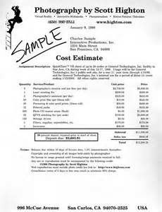
Does it need multiple quotes?
Materials, Supplies and Equipment that cost over $10,000 need three quotes.
Over the formal bid limit of $95,200 needs the formal bid process.
Construction or Labor that costs over $5,000 needs three quotes.
Over the formal bid limit of $15,000 needs the formal bid process.

Slide 9
2. Who is responsible for obtaining these quotes?
It is the Purchasing Department’s responsibility to obtain the quotes.
However for technical items or for those that require a visit to the campus, it is more efficient for the campus to obtain the quotes.
Why? The expertise lies in the staff requesting the equipment and they have excellent knowledge of the installation area and any concerns.

Slide 10
3. There is no other vendor that supplies the specialty equipment I need, so why is Purchasing telling me they still need to get quotes?
Even if only one vendor says that they can supply the equipment to you, we must check for other vendors and attempt to get quotes from other distributors.
Also, it may be true that one vendor supplies the exact item you want, but as a public agency, we are required to issue specifications with the words “or equal” that allow for other manufacturers to provide similar or like items. So we are required to get quotes that way as well.
However, if we obtain a quote that is lower priced for different equipment, we will come back to the user and ask for a specific justification as to why the other equipment does not meet the specification. This needs to be very specific information.

Slide 11
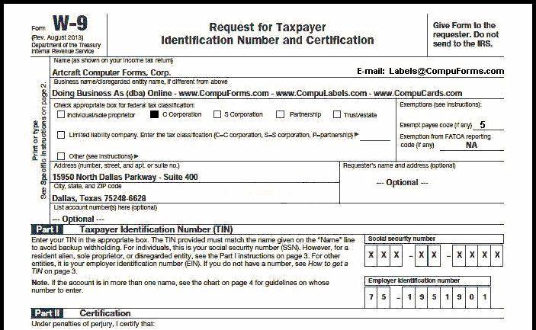
4. Is it a new vendor to the District?
All new vendors must supply a W-9 to the District with all of their business information and their taxpayer identification number and status.

Slide 12
5. Is it a professional service that requires a contract?
All professional services and any other documents that require a signature on behalf of the District require a Service Requisition to be entered into the Workday system.
In addition, a scope of work with pertinent information such as description of services, dates of services, and lump sum total or hourly rates (as applicable) needs to be uploaded to your requisition.

Slide 13
6. I entered a PR a week ago and Purchasing hasn’t processed it yet – why not?
Check in workflow to see where the requisition is currently and who needs to approve it before Purchasing can process it.
There are many people that electronically approve your requisitions in a variety of roles that must route before the PR comes to Purchasing for processing. This can sometimes take a couple of weeks before the PR is approved at the campus level.
Even though these approvals are done electronically, the process can take even longer when one of the approvers is on vacation, out sick or just busy with meetings, etc.
The majority of requisitions are processed within a day or two of arriving in the Purchasing & Contracts department.

Slide 14
7. Did you provide all of the information for your request?
If you obtained a quote, did you forward it to us so we have it?
Has the quote expired, thus requiring us to get a new one?
Did you give as much information as possible on the requisition so we know what you want specifically and a contact person in case we need to contact them for clarification?

Slide 15
Contracts Process

Slide 16
Q: How many contracts does Purchasing process on an annual basis?
Approximately 1,000 with a total value of approximately $25,000,000.

Slide 17
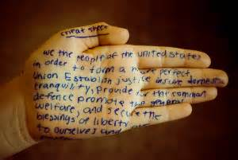
Contract Processing—Helpful Hints (I of VI)
All Service Requisitions for contracts should have something attached as backup – either a scope of work/proposal, maintenance contract, quote or hourly rates on the vendor’s letterhead.
Be sure that any attachment, such as quotes, have not expired.
It is ideal not to have an expiration date on quotes, but if required, we recommend 60-90 days.
Contracts can be signed for multiple years, but can only be encumbered for one fiscal year at a time.
If you have a multi-year contract, you will need to process a Change Order requisition for each fiscal year to encumber the money, even if no new contract paperwork is required.

Slide 18
Contract Processing—Helpful Hints Continued (II of VI)
Contract amendments require a Change Order requisition to amend the terms and to encumber additional money, if necessary. Even if the amendment is a “no cost” change order such as extending the completion date, a Change Order PR needs to be done for electronic approvals and to memorialize the change(s).
Where possible, try and encumber on the high side so you won’t have to do contract amendments as this will reduce staff work on both sides.
Contracts for services cannot exceed a term of five years.
We can continue using a vendor beyond the five year period, but every five years a new contract is required.
There are only two positions authorized to sign contracts – the Vice Chancellor-Business Services and the Director, Purchasing & Contracts so please don’t sign any contracts as they will not be valid.
Contracts are not reviewed prior to arriving in Purchasing as a fully approved Service requisition. The fully approved PR is the College approval that Purchasing may now finalize and enter into the contract the College has requested, so we begin work on it at that point.
Even though all contracts are required to be submitted to the Governing Board, the date that these are presented to the Board has no bearing on the contract start date. Purchasing has been delegated the authority to enter into contracts and the Board will ratify or approve after the fact at a subsequent meeting.

Slide 19
Contract Processing—Helpful Hints Continued (III of VI)
Employees cannot be an employee and a consultant – employees that perform additional duties need to be paid as an employee and not a consultant through the contract process.
Contract dates need to be within the specified time frame of when services and subsequent invoices will be submitted. In other words, if a request comes through for the contract period September 1, 2019 through June 30, 2020 and we receive invoices for work done in August, the contract is not valid and an amendment will need to be completed that changes the start date back to the prior date when services were performed.
The requisition, contract documents and/or backup must all match with regards to contract period, scope of work and dollar amount.
If you are working with the consultant for a professional service contract, please make sure that the consultant knows the legal name of the District, which is “Grossmont-Cuyamaca Community College District” or “Grossmont-Cuyamaca Community College District on behalf of Cuyamaca or Grossmont College.” Neither College is its own legal entity with a taxpayer identification number and, therefore, cannot be named as a legal entity in a contract.

Slide 20
Contract Processing—Helpful Hints Continued (IV of VI)
No vendor is authorized to perform any services prior to having a contract and/or purchase order issued by the District (Purchasing & Contracts department).
Please exercise caution when discussing services with vendors so that you are not directing them to start work as there is no financial obligation by the District if this is done by someone other than the delegated staff within the District.
Services provided either on or off campus require a PR and subsequent contract as work is being done for the District and both include insurance on the part of the vendor.
Professional consultant services do not require three quotes, but can simply have one proposal and a subsequent contract issued to the consultant.

Slide 21
Contract Processing—Helpful Hints Continued (V of VI)
Services for work to be done, such as landscaping or fencing, require three quotes if over $5,000 and must be attached to the PR as backup.
The College will obtain the quotes as typically the contractors are asked to inspect the area and get a description of the work to be performed.
If the work for these types of services exceeds $15,000, the formal bid process must be initiated per California law.
Even if something does not appear to be a contract (i.e. one-time advertisement), but the vendor requires a document to be signed on behalf of the District, a Service requisition needs to be generated with the document uploaded to the PR in order for the document to be signed.

Slide 22
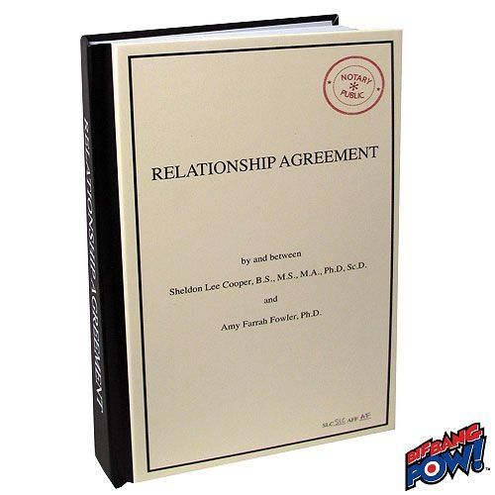
Contract Processing—A Final Thought on Helpful Hints
Memorandum of Understanding (MOU) documents are treated in the same manner as contracts, as they require a signature on behalf of the District. Therefore, MOU documents require a Service type requisition and subsequent contract to be issued, even though typically there are no payments to be made.
If in doubt or you have any questions, please feel free to contact the Purchasing & Contracts department at extension 7585.
We are here to help.

Slide 23
Charge It! Credit Card Processing

Slide 24
Q: How many credit card transactions does Purchasing audit on an annual basis?
Approximately 6,412 with a total value of approximately $1,000,000.

Slide 25
AUTHORIZED PURCHASES
Supply Purchases under $500 per Transaction
Transactions limited to $50 or less:
Postage
Federal Express
UPS
Duplicating/Copying of Material
Transactions limited to $200 or less:
Software
The credit card application and agreement forms can be found on Forms Depot and both items are required for all credit card requests.

Slide 26
PROHIBITED PURCHASES
Any Purchase over $500
Equipment over $500
All Computer Equipment regardless of cost including computers, printers, scanners, etc.
Services of Any Kind
Consultants, Instructors, and Speakers
Personnel Costs/Labor Charges
Items for Personal Use
Maintenance or Service Agreements
Rental Agreements, Facility Leases or Rentals, Equipment Rental, Etc.
Lease/Purchase Agreements

Slide 27
PROHIBITED PURCHASES CONTINUED
Facility Improvements
Membership Purchases
Software over $200
Travel Expenses (Air Fare, Ground Transportation, Lodging, Conference Fees, Meals)
Meals or Refreshments Served in a Restaurant
Food/Refreshments for Office Celebrations or Parties
Party Decorations
Postage, Federal Express, or UPS over $50
Duplicating/Copying of Material over $50
Off-Site Printing
On-line Database Subscriptions Requiring a Signed Agreement

Slide 28
PROHIBITED PRACTICES
Cash Refunds
Cash Advances
Split Orders of Multiple Items into Two or More Transactions to Avoid $500 Limit
Using Card Two Times for One Purchase, Total over $500
Transferring Cards between Individuals
Allowing Another Department to Use Card, then Transferring Expense
Using Card for Personal Purchases, then Reimbursing District Later
Additional Notes:
Itemized receipts are required to be provided with your monthly statement, not just the credit card receipt showing the charge amount.
Individual purchases made over the course of a couple or several days in a row to the same vendor for similar items with each purchase being just under the $500 limit constitutes a “split purchase” in the mind of our auditors.

Slide 29
Utilizing any of the prohibited practices may result in your credit card being revoked permanently.

Slide 30
Helpful Purchasing Tips from the Buyers

Slide 32
Processing Computer Orders

Slide 33
Pre-populated Descriptions for Easy Ordering – Copy and Paste Information Already in the Description (DELLSF1, DELLDT1, DELLMF1, DELLALL-24, DELLAT1-27, DELLAD1). These are updated and posted on the intranet at the following link:
https://intranet.gcccd.edu/it/default.html
All line items that are not included on the intranet link above must have a quote from the company and uploaded to the PR as an attachment.
All line items must have all information for each line item.
Do not simply reference, “DELLSF1 line item #1” as your description.
Purchasing does not configure, recommend or provide suggested computer equipment that you need to purchase.
This is done through the IT department or the network specialists at your campus.

Slide 34
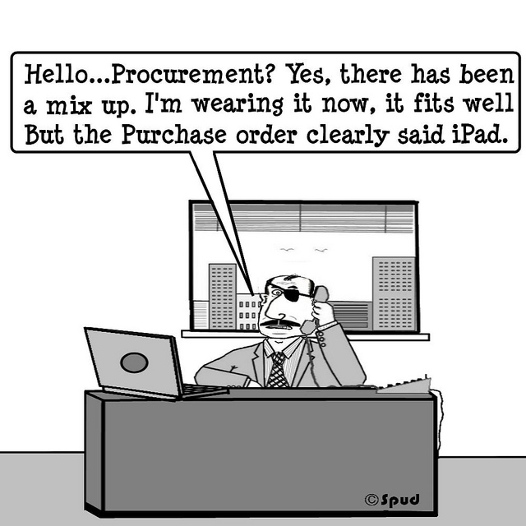
Non-Standard Items – Please make sure you have complete descriptions so we order the correct item for you. Otherwise, this may happen:

Slide 35
Processing Athletics, Office Depot, and CSEA Computer Lottery Orders

Slide 36
Q: What is the total dollar amount of Office Depot transactions input on an annual basis?
Approximately $184,600

Slide 37
Athletics
Athletic vendors are notorious for shipping items without a purchase order, which is against District policy.
You should simply get a quote from the vendor and then enter a PR into Workday which will route to Purchasing for us to order for you.
Purchasing will issue the purchase order from the vendor that provides the best pricing and the items will be shipped to the campus warehouse.
Do not order items directly with a vendor then submit a requisition to simply pay the invoice for items received.
You will receive a notification from the department and run the risk of being personally, financially obligated to pay the vendor.

Slide 38
Office Depot
We have several categories blocked on the online ordering system such as equipment, furniture, food, etc.
If you do not have online access, you will be required to submit a PR in Workday that will be processed by Purchasing with a purchase order issued to the vendor.
Please contact Amy Leasure for an Office Depot application.

Slide 39
CSEA Computer Lottery
When you are selected to be a recipient for the computer lottery, Purchasing will place the order with the vendor and then a loan agreement will be generated.
You will not be able to pick up your computer equipment until the loan agreement has been fully executed and all information provided.
Computer lottery purchases are limited to the equipment and vendors that the District uses for computer purchases.

Slide 40
Processing Reimbursement and Membership Orders

Slide 41
Q: How many requisitions does Purchasing process on an annual basis?
Approximately 3,669 with a total value of approximately $13,000,000.

Slide 42
Reimbursements
You must provide itemized receipts and clear documentation for method of payment that clearly shows who paid the expense.
Reimbursements are done through the Expense Report process in Workday and are processed by the Accounting Department.
Payment can only be made directly to the person who incurred the charge and that person must be a District employee.
If you are being reimbursed for food and beverage expenses provided at a campus meeting and the total is over $400 and was not purchased from Sodexo, you must provide the letter from Sodexo indicating they were given the opportunity for the catering but declined.
You are not authorized to purchase equipment and then ask for reimbursement.
There are few instances that allow you to utilize the reimbursement process.

Slide 43
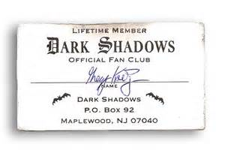
Memberships
These must be processed on a PR through Purchasing, as there are several steps that are done by Purchasing to accommodate these requests.
No personal memberships are allowed unless you are using approved Professional Enhancement/Development funds, trust funds or it is a required component of your employment contract.

Slide 44
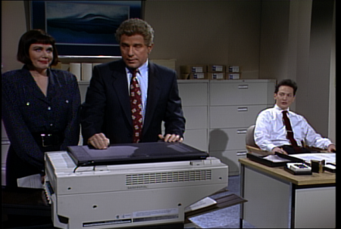
Copier Standardization - Xerox

Slide 45
Workday Update

Slide 46
Cool and Exciting List of Improvements

Slide 47
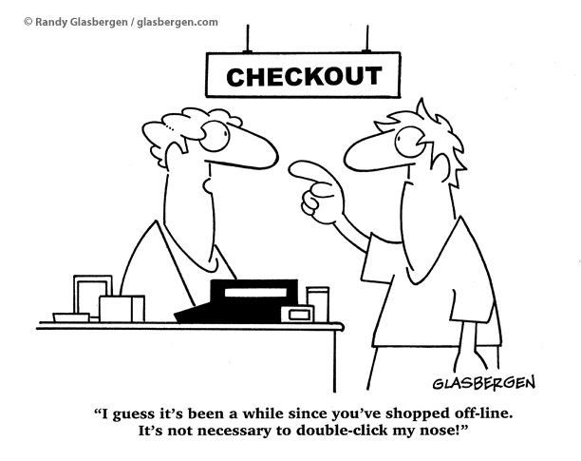

Slide 48
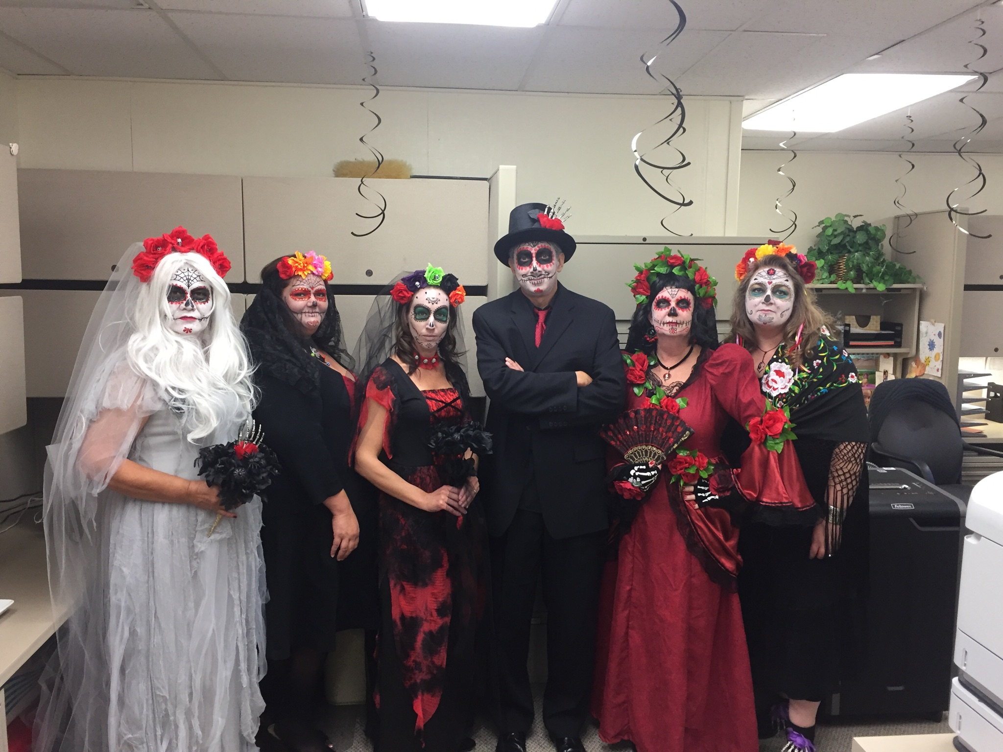
Purchasing & Contracts— This is who we are:

Slide 49
Questions?

